Slide 1



Phishing Attacks: What You Need to Know
Phishing attacks are a major threat to individuals and organizations. Understanding these attacks is crucial for protecting yourself and your data.
by Malik Ali Raza

Slide 2

What is Phishing?
Phishing is a type of cybercrime where attackers attempt to trick victims into revealing sensitive information, such as passwords, credit card details, or personal data.
Goal
The goal of phishing is to gain access to your accounts or steal your identity.
Methods
Attackers use various methods, including emails, text messages, and fake websites.

Slide 3
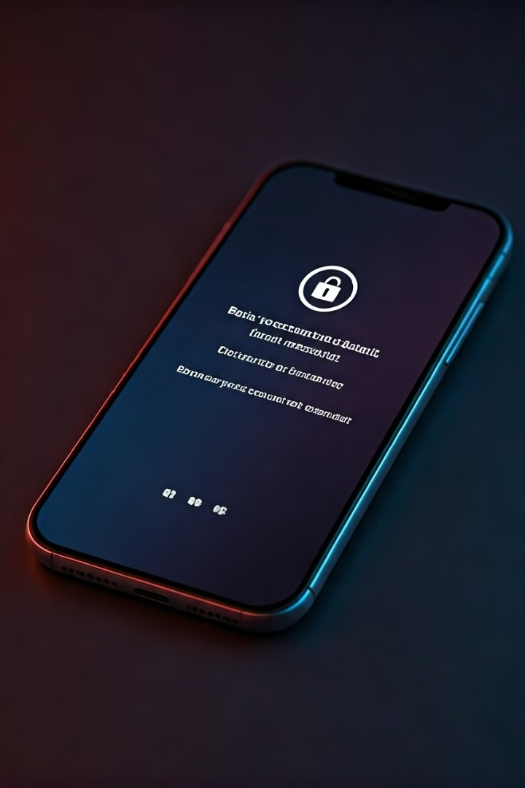
Common Phishing Tactics
Attackers use various tactics to make their phishing attempts appear legitimate.
1
Urgency
Phishing emails often create a sense of urgency to trick you into acting quickly.
2
Social Proof
Attackers may use fake testimonials or endorsements from trusted sources.
3
Emotional Manipulation
Attackers might try to evoke fear, excitement, or curiosity to lure you in.

Slide 4
Identifying Phishing Emails
Learn to identify red flags that can signal a phishing email.
Sender Address
Grammar & Spelling
Suspicious Links
Check if the sender's email address is legitimate and matches the sender's name.
Look for typos, grammatical errors, or unusual language.
Hover over any links before clicking to see the actual URL in the status bar.

Slide 5




Recognizing Suspicious Websites
Be cautious of websites that look similar to trusted ones.
URL
Security Certificate
Website Design
Check the website's URL for typos, misspellings, or unusual characters.
Look for a padlock icon in the address bar and verify the website's security certificate.
Compare the website's design to the original website for any inconsistencies.

Slide 6

Social Engineering Techniques
Attackers use social engineering to exploit human psychology to gain access to information.
Pretexting
Creating a false story to gain trust
Baiting
Offering tempting rewards or freebies
Scareware
Using threats or fear to manipulate victims

Slide 7

Protecting Yourself from Phishing
Take proactive steps to protect yourself from phishing attacks.
1
Strong Passwords
Use strong, unique passwords for all your accounts.
2
Two-Factor Authentication
Enable two-factor authentication on your accounts for an extra layer of security.
3
Be Cautious
Think twice before clicking on links or opening attachments.

Slide 8

Best Practices for Employees
Educate your employees about phishing threats and implement best practices.
1
Training
Provide regular phishing awareness training to employees.
2
Policies
Establish clear policies regarding phishing and data security.
3
Reporting
Encourage employees to report any suspicious emails or websites.

Slide 9




Reporting Suspected Phishing Attempts
Report any suspected phishing attempts to the appropriate authorities.
Email Provider
Website Owner
Law Enforcement
Report the phishing email to your email provider.
Contact the website owner if you encounter a fake website.
Report the incident to law enforcement agencies.

Slide 10
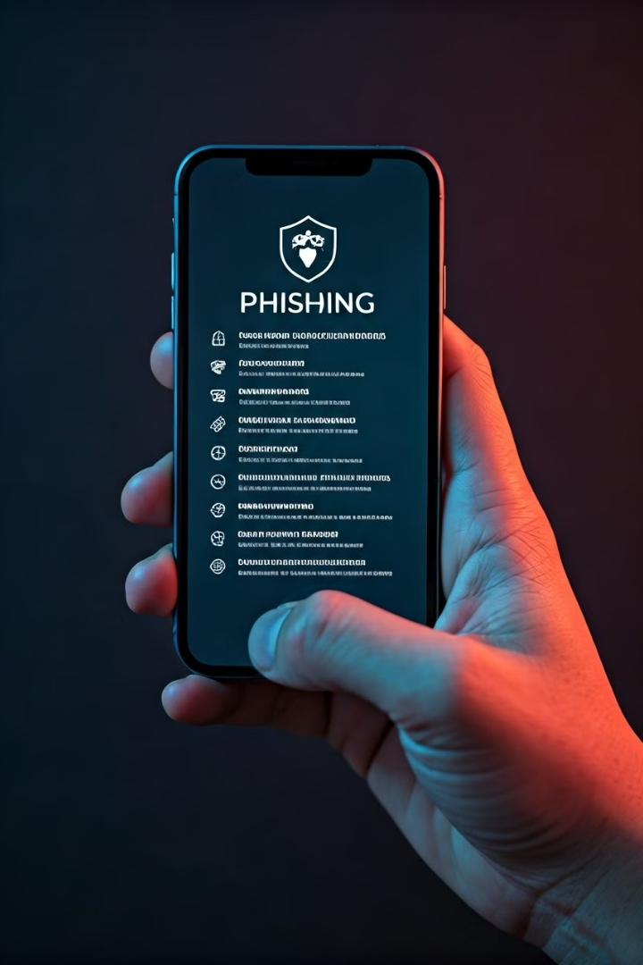
Conclusion and Resources
Stay informed about phishing attacks and learn about resources to protect yourself.
1
Stay Updated
Stay informed about the latest phishing scams and best practices.
2
Trusted Resources
Refer to reputable resources for information about phishing.

